Slide 1


DEGRADATION OF ROCK JOINT ROUGHNESS AND ITS QUANTIFICATION
Presented By:
Harsh Khurdi (2022CEB1009)
Kirti Kumar Meena(2022CEB1014)
Mankaran Singh(2022CEB1015)
Pratibha Meena(2022CEB1021)
Under the supervision of
Dr. Resmi Sebastian
1

Slide 2

01
INTRODUCTION
Rock joint roughness is one of the most influential factors controlling the shear strength, deformation behaviour of rock masses and long-term stability of rock masses. When a joint undergoes shearing, the small surface irregularities, or asperities, break, slide, or wear down, which leads to a gradual reduction in roughness. This change affects the performance of rock structures such as tunnels, slopes, and foundations. Understanding this degradation is essential for accurately predicting joint behaviour under loading.
The analysis of joint roughness has traditionally relied on profile-based measurements and empirical parameters. However, these methods often fail to capture the detailed three-dimensional evolution of joint surfaces during shearing. Recent advancements in digital imaging and photogrammetry provide a powerful alternative for obtaining high-resolution surface models before and after mechanical testing.
In this project, the degradation and quantification of rock joint roughness are investigated using a combination of experimental and digital methods. Artificially roughened joint surfaces are created using Plaster of Paris (POP) to ensure controlled and repeatable asperity geometries. These samples are subjected to laboratory direct shear tests, and their surface conditions are captured through photogrammetry both prior to and following shearing. The resulting 3D models allow accurate assessment of roughness parameters and their evolution with displacement.
Overall, this work aims to quantify how joint roughness degrades during shearing and to analyse how these changes influence the mechanical behaviour of the joint.
2

Slide 3
OBJECTIVES
1.
To prepare Plaster of Paris (POP) joint samples that replicate natural rock joint roughness.
Plaster of Paris (POP) is used because it is easy to mold, economical, and capable of capturing fine asperity details. Artificial roughness profiles are then transferred into POP molds to produce samples having upward and downward matching roughness. This allows for a controlled study of how joint asperities behave under shear loading, closely simulating real rock joint conditions.
2.
To conduct direct shear tests on the prepared samples and measure the degradation.
It involves subjecting the prepared POP joint samples to direct shear testing using a standard shear box apparatus. During the test, the applied shear load, displacement, and vertical deformation are monitored. As shearing progresses, the asperities on the joint surface undergo processes such as sliding, crushing, and wear. Recording these responses helps identify peak shear strength, residual strength, dilation, and the onset of asperity damage. The direct shear test therefore serves as the primary method for generating mechanical data that reflect how roughness degrades when the joint is sheared.
3.
To estimate the initial surface roughness of POP joint samples before and after testing using photogrammetry techniques.
It aims at digitally capturing the 3D surface topography of the joint before and after shearing. Photogrammetry is used to obtain high-resolution point clouds and mesh models of the joint surface. By taking multiple overlapping photographs and processing them using a 3D reconstruction software, an accurate digital surface model is generated. This technique is non-contact, precise, and allows detailed analysis of asperity height, spacing, and morphology. It enables direct comparison of how the micro-geometry of the joint changes due to shearing.
3

Slide 4
4. To quantify changes in joint roughness before and after direct shear testing.
Once the pre- and post- shear photogrammetric models are obtained, the next objective is to measure and quantify the degradation in joint roughness. This is done using scanline analysis, computation of Z₂ roughness parameters, and estimation of the Joint Roughness Coefficient (JRC) through different empirical models. Quantifying this change allows the relationship between surface morphology and mechanical response to be understood. Comparing roughness before and after shearing highlights how asperity breakage reduces JRC and influences shear strength, thus linking surface degradation directly with joint behavior.
4

Slide 5
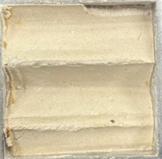
METHODOLOGY
1. SAMPLE PREPARATION
Two Plaster of Paris (POP) joint samples are prepared using a mould such that the artificial roughness pattern to be imprinted directly onto the POP surfaces. The roughness profiles are created, which ensure that the upper and lower halves match accurately. After casting, the samples are kept for drying until they attain a constant weight to ensure stable testing conditions.
Sample Dimensions of Lower Half Sample and Upper Half Sample are 60 mm × 60 mm × 25 mm and the Artificial asperities are imprinted on the bottom surface and on the top surface respectively and the after dried, the Constant weight is 82.3 g.
fig. pop sample
2. PRE-SHEAR ROUGHNESS MEASUREMENT
Photogrammetry is used to capture high-resolution images of joint surfaces.
A 3D model of the surface was generated and roughness indices (Z2, JRC-equivalent values) were extracted.
Photos were taken with 70–80% overlap and uniform lighting to ensure accurate 3D reconstruction.
5

Slide 6
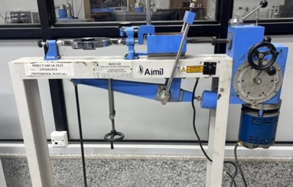
3. DIRECT SHEAR TESTING
The lower POP sample is placed inside the lower half of the shear box.
The upper POP sample is placed inside the upper half of the shear box.
The two roughness profiles are aligned accurately, allowing peaks to fit properly.
An initial gap of approximately 0.5 mm exists before applying normal load, and this
gap closes when the load is applied.
Tests were performed under controlled normal loads.
Peak shear strength, residual shear strength, and shear stiffness were computed.
Normal stress applied: 1.0 MPa.
fig. Direct Shear Test Apparatus
4. POST-SHEAR ROUGHNESS MEASUREMENT
The same photogrammetry procedure is repeated after shearing.
5 DATA ANALYSIS
Post-shear roughness are compared against pre-shear data.
Degradation and asperity damage distribution are evaluated.
Relationship between degradation and shear strength reduction are studied.
6

Slide 7
WORK PROGRESS SO FAR
1. POP SAMPLE PREPARATION
Samples are cast in a mold, dried to constant weight, and assembled in the shear
box.
2. ROUGHNESS MEASUREMENT COMPLETED DIRECT SHEAR TEST
Direct shear tests are successfully conducted on the prepared POP samples.
Shear stress, horizontal displacement, and vertical deformation are recorded at regular
intervals.
Peak shear strength, dilation behavior, and residual strength are obtained from the test
results.
7

Slide 8
3. PRE-SHEAR AND POST-SHEAR PHOTOGRAMMETRY FOR SAMPLE SURFACE.
Photogrammetry is performed on the joint surfaces before and after shearing to
capture 3D roughness data.
Roughness indices (asperity height, Z2, and JRC) reduce significantly after shearing,
confirming the occurrence of asperity damage.
4. DATA ANALYSIS
It demonstrates that asperity degradation leads to reduced peak strength and lower
shear stiffness.
It validates that surface morphology plays a critical role in controlling shear
resistance, and photogrammetry effectively quantifies roughness evolution.
8

Slide 9
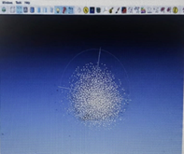
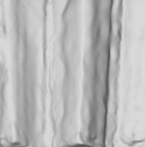
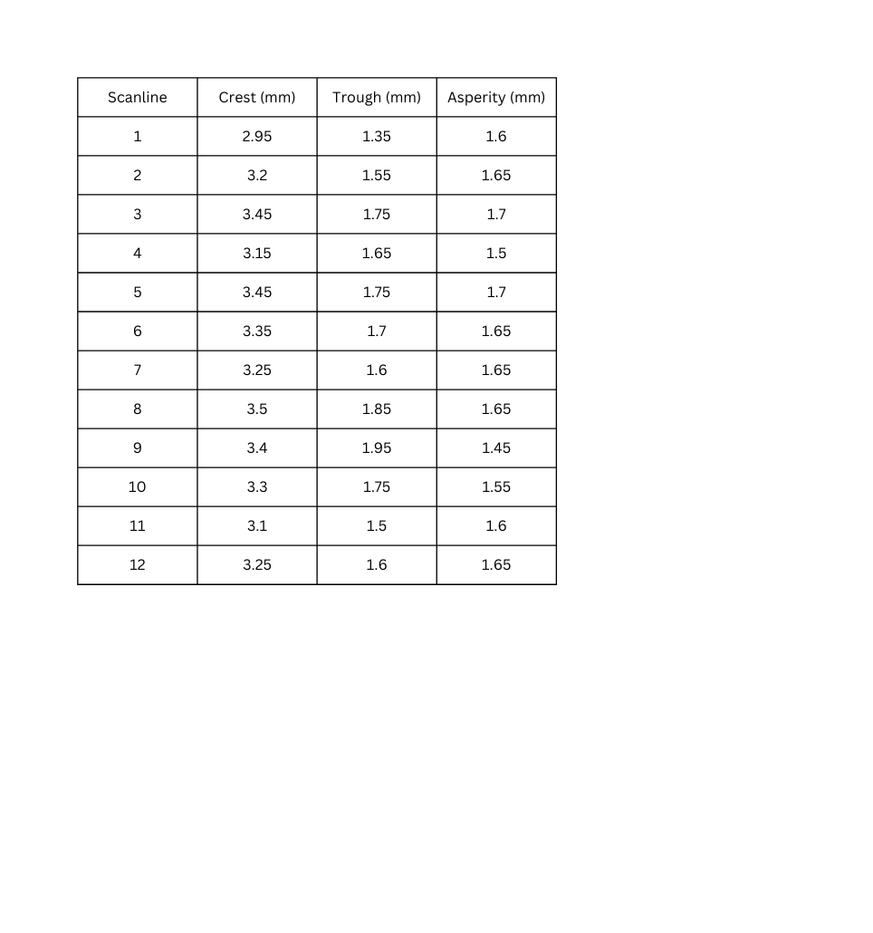
FINDINGS/RESULT
1.PRE-SHEAR PHOTOGRAMMETRY ANALYSIS
Surface Profile Extraction Data (12 Scanlines) across sample surface (in cloudcompare)
FIG. POINT CLOUD OF THE 3D SURFACE
FIG. THE IMAGE OBTAINED FROM
3D SCANNING
1.1. STATISTICAL ANALYSIS
(CREST AND TROUGH COORDINATES MEASURED IN MM; ASPERITY = CREST - TROUGH)
Maximum asperity: 1.70 mm (from Scanline 3 and 5)
A maximum asperity of 1.70 mm indicates a significant vertical irregularity on the rock joint surface. This value is a direct measure of the peak-to-trough height of the largest roughness feature found along the scanline.
9

Slide 10
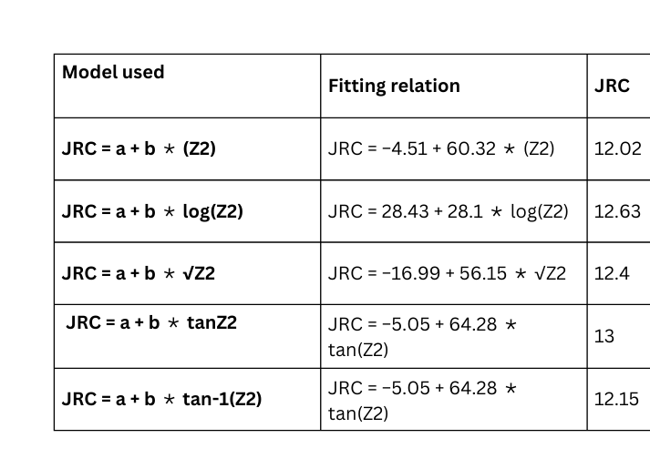
1.2. ROUGHNESS ANALYSIS (JRC CALCULATION)
ROOT MEAN SQUARE(Z2) = MAXIMUM ASPERITY / SAMPLING INTERVAL
Maximum Asperity = 1.70 mm
Sampling Interval = 6.20 mm
Z2 = 1.70 / 6.20 = 0.274
JRC Using Empirical Equations
1.3. Average JRC (Pre-Shear)
JRC average = 12.44
1.4. According to Barton & Choubey (1977) Classification
JRC 12-14: rough and undulating surface
Classification: The artificial roughness created falls into " Rough and Undulating " category, which is appropriate for demonstrating significant shear strength enhancement and subsequent degradation.
10

Slide 11
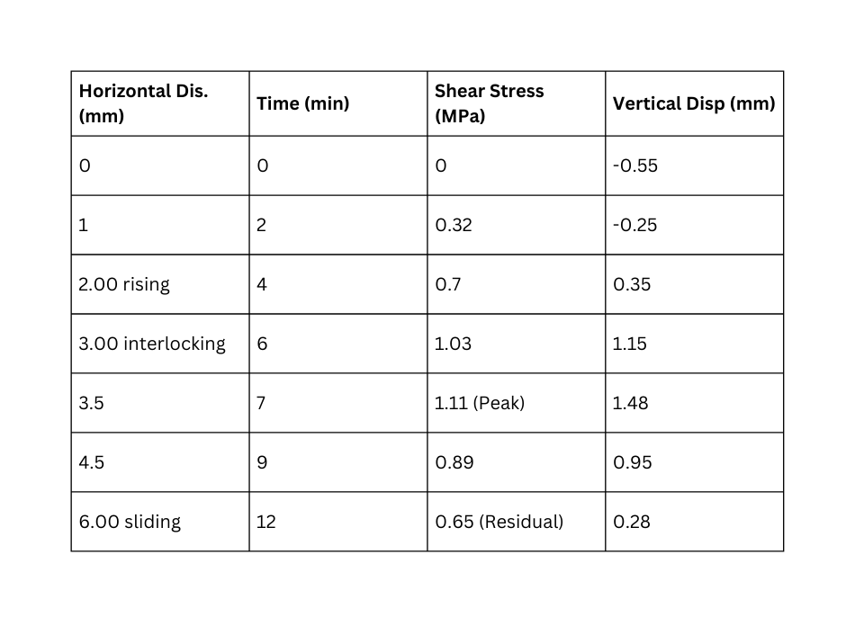
2.DIRECT SHEAR TEST RESULTS
2.1. Peak Shear Stress
Peak shear stress occurs at 3.50 mm displacement
τₚ = 1.11
2.2. Residual Shear Stress
Residual stress reached at 6.00 mm displacement
τᵣ = 0.65 MPa
2.3. Dilation Behavior
Initial compression: –0.55 mm
Maximum dilation: 1.48 mm (near peak)
At residual: 0.28 mm
2.4.Mode of Joint Failure
The joint exhibits a distinct dilative response at the beginning of shearing, accompanied by noticeable asperity climbing as the rough
surfaces engage. Peak shear strength is reached at approximately 3.5 mm of horizontal displacement, where strong asperity interlocking
occurs. Beyond the peak, a reduction in shear stress is observed due to progressive asperity damage, crushing, and shearing off.
As the asperities degrade, the joint transitions into a residual strength zone, characterized by smoother sliding and minimal dilation.
11

Slide 12
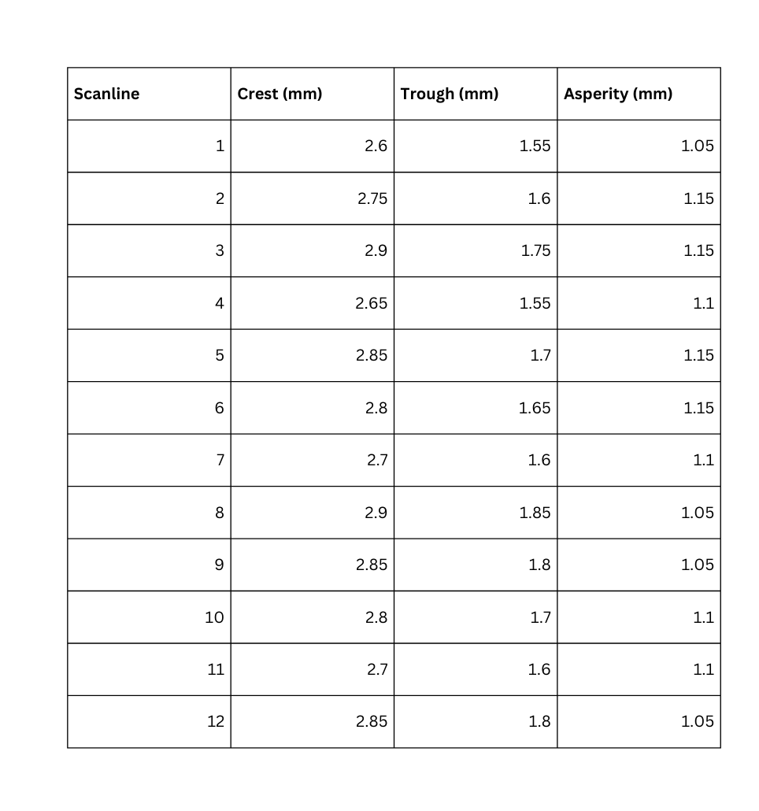
3. POST-SHEAR PHOTOGRAMMETRY ANALYSIS
3.1. SURFACE PROFILE EXTRACTION DATA (12 SCANLINES) ACROSS SAMPLE
SURFACE (IN CLOUDCOMPARE)
3.2. STATISTICAL ANALYSIS
Maximum asperity: 1.15 mm (from Scanline 2,3,5 and 6)
The maximum asperity height of 1.15 mm indicates a clear vertical irregularity on the joint
surface. This value represents the peak-to-trough height of the most prominent surface
feature measured along the scanlines.
3.3. ROUGHNESS ANALYSIS (JRC CALCULATION)
ROOT MEAN SQUARE(Z2) = MAXIMUM ASPERITY / SAMPLING INTERVAL
Maximum Asperity = 1.15 mm
Sampling Interval = 6.20 mm
Z2 = 1.15 / 6.20 = 0.185
12

Slide 13
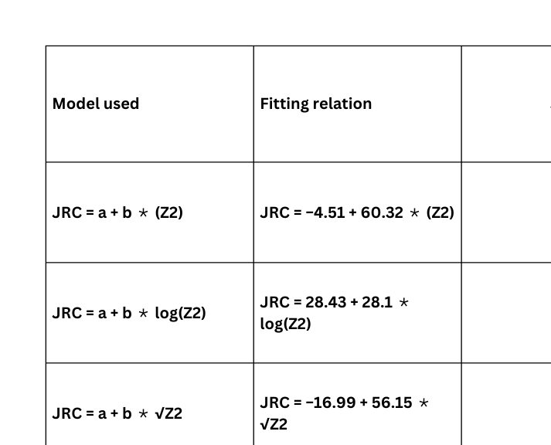
3.4. AVERAGE JRC (POST-SHEAR)
JRC average = 7.07
3.5. ACCORDING TO BARTON & CHOUBEY (1977) CLASSIFICATION
JRC 6-8: rough and planar surface
Classification: The artificial roughness created falls into " Rough and planar " category,
which is appropriate for demonstrating significant shear strength enhancement and
subsequent degradation.
Due to the crushing and degradation of asperities during shearing, the joint surface
becomes smoother, resulting in a noticeable decrease in its JRC value.
13

Slide 14
6. FUTURE WORK PROPOSED
1. CONDUCT EXPERIMENTS ON DIFFERENT ROUGHNESS CATEGORIES.
The study can be extended by preparing POP samples with varying roughness types
(smooth, moderately rough). This will allow a more detailed understanding of how different
asperity geometries influence shear strength and degradation.
2. STUDY THE INFLUENCE OF ENVIRONMENTAL CONDITIONS
Future work may include investigating how factors such as moisture content, wet–dry
cycles, and temperature variations affect roughness degradation and shear strength. This
will make the findings more applicable to field conditions.
3. DEVELOP PREDICTIVE MODELS FOR ROUGHNESS DEGRADATION
Machine learning or regression-based models can be developed using pre- and post-shear
datasets to predict roughness reduction and JRC evolution. This will help automate
roughness quantification and improve forecasting of long-term joint behavior.
14

Slide 15
FUTURE WORK PROPOSED
4. PERFORM DIRECT SHEAR TESTS UNDER MULTIPLE NORMAL STRESSES
Future work can include conducting direct shear tests at different normal stresses (e.g., 0.5
MPa, 1 MPa, 1.5 MPa, 2 MPa) to study how confinement influences roughness degradation,
dilation behavior, and shear strength. This will help establish a more complete shear
strength envelope for joints with varying roughness.
15

Slide 16
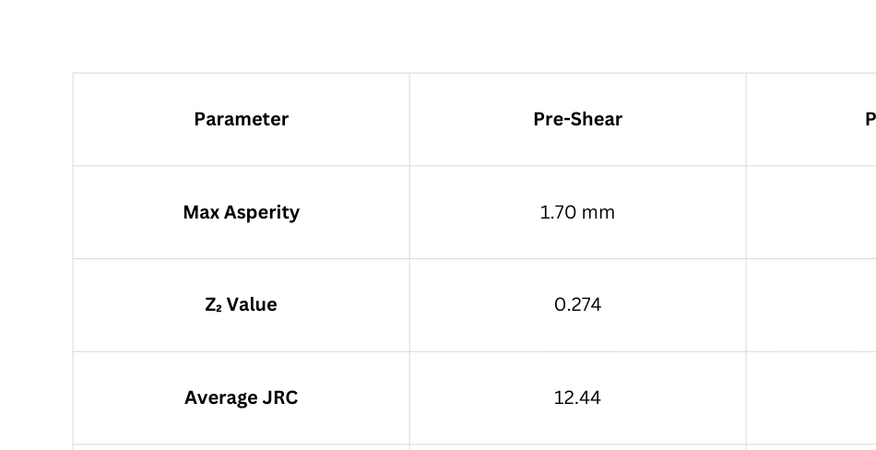

CONCLUSION
Pre-shear JRC = 12.44 → rough & undulating
Post-shear JRC = 7.07 → rough & planar
Asperity height reduced by 32.3% (1.70 → 1.15 mm)
JRC reduced by 43.2%, showing significant degradation
Peak shear stress dropped from 1.11 MPa to 0.65 MPa residual
Photogrammetry accurately captured surface damage
16

Slide 17
REFERENCES
Rohilla, S., & Sebastian, R. (2023). Determination of joint roughness coefficient using a cost-effective photogrammetry technique. Bulletin of Engineering Geology and the Environment, 82, Article 125.
https://doi.org/10.1007/s10064-023-03135-1.SpringerLink
Thirukumaran, S., & Indraratna, B. (2016). A review of shear strength models for rock joints subjected to constant normal stiffness.
Journal of Rock Mechanics and Geotechnical Engineering, 8, 405–414. https://doi.org/10.1016/j.jrmge.2015.10.006.Opus at UTS
Abolfazli, M., & Fahimifar, A. (2020). An investigation on the correlation between the joint roughness coefficient (JRC) and joint roughness parameters. Construction and Building Materials, 259, 120415.
https://doi.org/10.1016/j.conbuildmat.2020.120415. ScienceDirect
Kulatilake, P. H. S. W., & Ankah, M. L. Y. (2023). Rock joint roughness measurement and quantification — A review of the current status. Geotechnics, 3, 116–141.
https://doi.org/10.3390/geotechnics3020008.
17

Slide 18
THANK YOU
18

